Slide 1
Social and Emotional Learning (SEL) – A Little Goes a Long Way
Facilitators Dr. Kimberly McLeod Texas A&M Commerce
Dr. Ellene Polidore Prime Squared Consulting, LLC.
Prime Squared Consultants, LLC

Slide 2
What is SEL?
Social and emotional learning (SEL) is the process through which children and adults understand and manage emotions, set and achieve positive goals, feel and show empathy for others, establish and maintain positive relationships, and make responsible decisions. https://casel.org/what-is-sel/

Slide 3
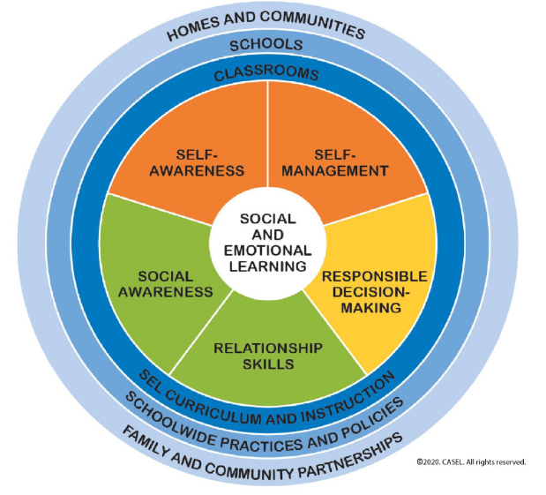
Social and Emotional Learning Competencies
SEL 5 Core Competencies
Self Awareness
Social Awareness
Self Management
Relationship Skills
Responsible Decision Making
https://casel.org/core-competencies/

Slide 4
Caveat for Students of Color
Do address the germs
Do address the racial unrest
Don’t say “I don’t see color”
Try to see systems that hurt students of color
Create a Professional Learning Community around SEL for students of color that includes Parents, teachers and students ( this goes above no place for hate and anti bullying)

Slide 5
Caveat for Teachers New T-Tess Evaluation for Virtual Learning
Planning Dimension 1.3V Knowledge of Students
Through knowledge of students and proven practices, the teacher ensures high levels of learning, social-emotional development and achievement for all students.
Instruction Dimension 2.1
Achieving Expectations
The Teacher supports all learners in their pursuit of high levels of academic and social-emotional success

Slide 6
Thank You!
Facilitators
Dr. Kimberly McLeod
Kimberly.Mcleod@tamuc.edu
Dr. Ellene Polidore www.primesquaredconsultants.com primesquaredconsultants@gmail.com

